Slide 1
Lesson 6
Writing Control Structures

Slide 2
Objective
After completing this lesson, you should be able to do the following:
  Identify the uses and types of control structures
  Construct an IF statement
  Use CASE statements and CASE expressions
  Construct and identify loop statements
  Use guidelines when using conditional control structures

Slide 3
Lesson Agenda
  Using IF statements
  Using CASE statements and CASE expressions
  Constructing and identifying loop statements

Slide 4






IF Statement
Syntax:
IF condition THEN
statements;
[ELSE
statements;]
END IF;
ELSE
THEN
IF statement
Notes:
Java SE 8 Programming 2 - <number>

Slide 5







IF-ELSIF Statements
ELSIF
IF condition THEN
statements;
[ELSIF condition THEN
statements;]
[ELSE
statements;]
END IF;
Then
ELSIF
Then
ELSIF
Then

Slide 6

Simple IF Statement
DECLARE
v_myage NUMBER := 10;
BEGIN
IF v_myage < 11
THEN
DBMS_OUTPUT.PUT_LINE(' I am a child ');
END IF;
END;

Slide 7

IF THEN ELSE Statement
DECLARE
v_myage number:=31;
BEGIN
IF
v_myage < 11 THEN
DBMS_OUTPUT.PUT_LINE(' I am a child ');
ELSE
DBMS_OUTPUT.PUT_LINE(' I am not a child ');
END IF;
END;
/

Slide 8

IF ELSIF ELSE Clause
DECLARE
v_myage number:=31;
BEGIN
IF v_myage < 11 THEN
DBMS_OUTPUT.PUT_LINE(' I am a child ');
ELSIF v_myage < 20 THEN
DBMS_OUTPUT.PUT_LINE(' I am young ');
ELSIF v_myage < 30 THEN
DBMS_OUTPUT.PUT_LINE(' I am in my twenties');
ELSIF v_myage < 40 THEN
DBMS_OUTPUT.PUT_LINE(' I am in my thirties');
ELSE
DBMS_OUTPUT.PUT_LINE(' I am always young ');
END IF;
END;
/

Slide 9

NULL Value an in IF Statement
DECLARE
v_myage number;
BEGIN
IF v_myage < 11 THEN
DBMS_OUTPUT.PUT_LINE(' I am a child ');
ELSE
DBMS_OUTPUT.PUT_LINE(' I am not a child ');
END IF;
END;
/

Slide 10






CASE Expressions
  A CASE expression selects a result and returns it.
  To select the result, the CASE expression uses expressions. The value returned by these expressions is used to select one of several alternatives.
CASE selector
WHEN expression1 THEN result1
[WHEN expression2 THEN result2
...
WHEN expressionN THEN resultN]
[ELSE resultN+1]
END;

Slide 11
Searched CASE Expressions
DECLARE
v_grade CHAR(1) := UPPER('&grade');
v_appraisal VARCHAR2(20);
BEGIN
v_appraisal := CASE
WHEN v_grade = 'A' THEN 'Excellent'
WHEN v_grade IN ('B','C') THEN 'Good'
ELSE 'No such grade'
END;
DBMS_OUTPUT.PUT_LINE ('Grade: '|| v_grade ||
' Appraisal ' || v_appraisal);
END;
/

Slide 12
CASE Statement
DECLARE
v_deptid NUMBER;
v_deptname VARCHAR2(20);
v_emps NUMBER;
v_mngid NUMBER:= 108;
BEGIN
CASE v_mngid
WHEN 108 THEN
SELECT department_id, department_name INTO v_deptid, v_deptname FROM departments
WHERE manager_id=108;
SELECT count(*) INTO v_emps FROM employees
WHERE department_id=v_deptid;
WHEN 200 THEN
...
END CASE;
DBMS_OUTPUT.PUT_LINE ('You are working in the '|| v_deptname||
' department. There are '||v_emps ||' employees in this
department');
END;
/

Slide 13
Handling Nulls
When you are working with NULL values, you can avoid some common mistakes by keeping the following rules in mind:
  Simple comparisons involving NULLs always yield NULL.
  Applying the logical operator NOT to a NULL yields NULL.
  If the condition yields NULL in conditional control statements, its associated sequence of statements is not executed

Slide 14
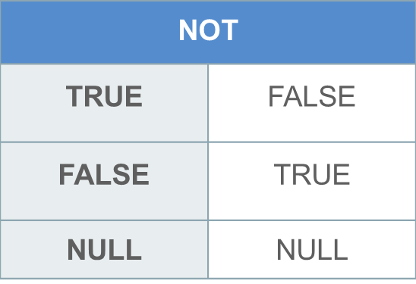
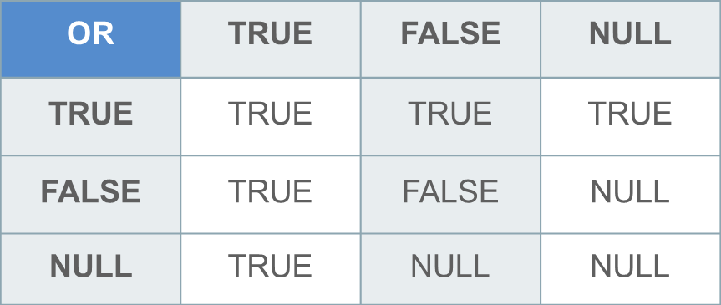
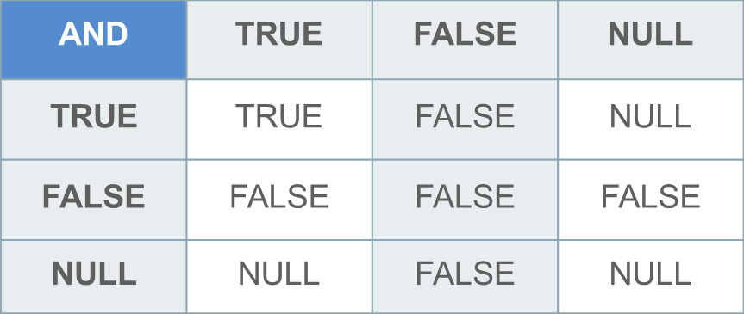
Logic Tables
The negation of NULL (NOT NULL) results in a null value because null values are indeterminate.
NOT
NOT
TRUE takes precedence in an OR condition.
FALSE takes precedence in an AND condition.

Slide 15
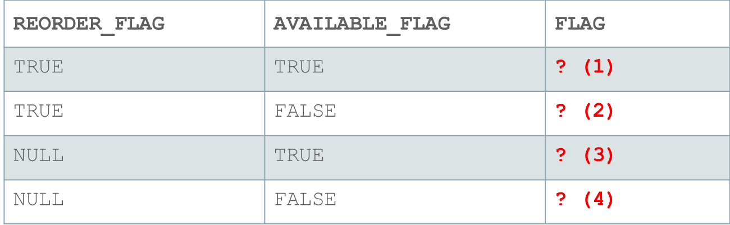
Boolean Expression or Logical Expression?
What is the value of flag in each case?
flag := reorder_flag AND available_flag;

Slide 16
Iterative Control: LOOP Statements
  Loops repeat a statement (or a sequence of statements) multiple times.
  There are three loop types:
    Basic loop
    FOR loop
    WHILE loop

Slide 17
Basic Loops
Syntax:
LOOP
statement1;
. . .
EXIT [WHEN condition];
END LOOP;

Slide 18
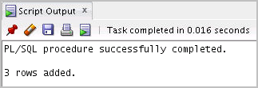
Basic Loop: Example
DECLARE
v_countryid locations.country_id%TYPE := 'CA';
v_loc_id locations.location_id%TYPE;
v_counter NUMBER(2) := 1;
v_new_city locations.city%TYPE := 'Montreal';
BEGIN
SELECT MAX(location_id) INTO v_loc_id FROM locations
WHERE country_id = v_countryid;
LOOP
INSERT INTO locations(location_id, city, country_id)
VALUES((v_loc_id + v_counter), v_new_city, v_countryid);
v_counter := v_counter + 1;
EXIT WHEN v_counter > 3;
END LOOP;
DBMS_OUTPUT.PUT_LINE(v_counter-1||' rows added.');
END;
/

Slide 19
WHILE Loops
Syntax:
WHILE condition LOOP
statement1;
statement2;
. . .
END LOOP;

Slide 20
WHILE Loops: Example
DECLARE
v_countryid locations.country_id%TYPE := 'CA';
v_loc_id locations.location_id%TYPE;
v_new_city locations.city%TYPE := 'Montreal';
v_counter NUMBER := 1;
BEGIN
SELECT MAX(location_id) INTO v_loc_id FROM locations
WHERE country_id = v_countryid;
WHILE v_counter <= 3 LOOP
INSERT INTO locations(location_id, city, country_id)
VALUES((v_loc_id + v_counter), v_new_city, v_countryid);
v_counter := v_counter + 1;
END LOOP;
DBMS_OUTPUT.PUT_LINE(v_counter-1||' rows added.');
END;
/

Slide 21
FOR Loops
  Use a FOR loop when you know the number of iterations.
  Do not declare the counter; it is declared implicitly.

Slide 22

FOR Loops: Example
DECLARE
v_countryid locations.country_id%TYPE := 'CA';
v_loc_id locations.location_id%TYPE;
v_new_city locations.city%TYPE := 'Montreal';
BEGIN
SELECT MAX(location_id) INTO v_loc_id
FROM locations
WHERE country_id = v_countryid;
FOR i IN 1..3 LOOP
INSERT INTO locations(location_id, city, country_id)
VALUES((v_loc_id + i), v_new_city, v_countryid );
END LOOP;
END;
/

Slide 23
FOR Loop Rules
  Reference the counter only within the loop; it is undefined outside the loop.
  Do not reference the counter as the target of an assignment.
  The loop bound should not be NULL.

Slide 24
Suggested Use of Loops
  Use the basic loop when the statements inside the loop must execute at least once.
  Use the WHILE loop if the condition must be evaluated at the start of each iteration.
  Use a FOR loop if the number of iterations is known.

Slide 25
Nested Loops and Labels
  You can nest loops to multiple levels.
  Use labels to distinguish between blocks and loops.
  Exit the outer loop with the EXIT statement that references the label.

Slide 26
Nested Loops and Labels: Example
...
BEGIN
<<Outer_loop>>
LOOP
v_counter := v_counter+1;
EXIT WHEN v_counter>10;
<<Inner_loop>>
LOOP
...
EXIT Outer_loop WHEN total_done = 'YES';
-- Leave both loops
EXIT WHEN inner_done = 'YES';
-- Leave inner loop only
...
END LOOP Inner_loop;
...
END LOOP Outer_loop;
END;
/

Slide 27
PL/SQL CONTINUE Statement
  Definition
    Adds functionality to begin the next loop iteration
    Provides programmers with the ability to transfer control to the next iteration of a loop
  Benefits
    Eases the programming process
    May provide a small performance improvement over the previous programming workarounds to simulate the CONTINUE statement

Slide 28
PL/SQL CONTINUE Statement
  Definition
    Adds functionality to begin the next loop iteration
    Provides programmers with the ability to transfer control to the next iteration of a loop
  Benefits
    Eases the programming process
    May provide a small performance improvement over the previous programming workarounds to simulate the CONTINUE statement

Slide 29
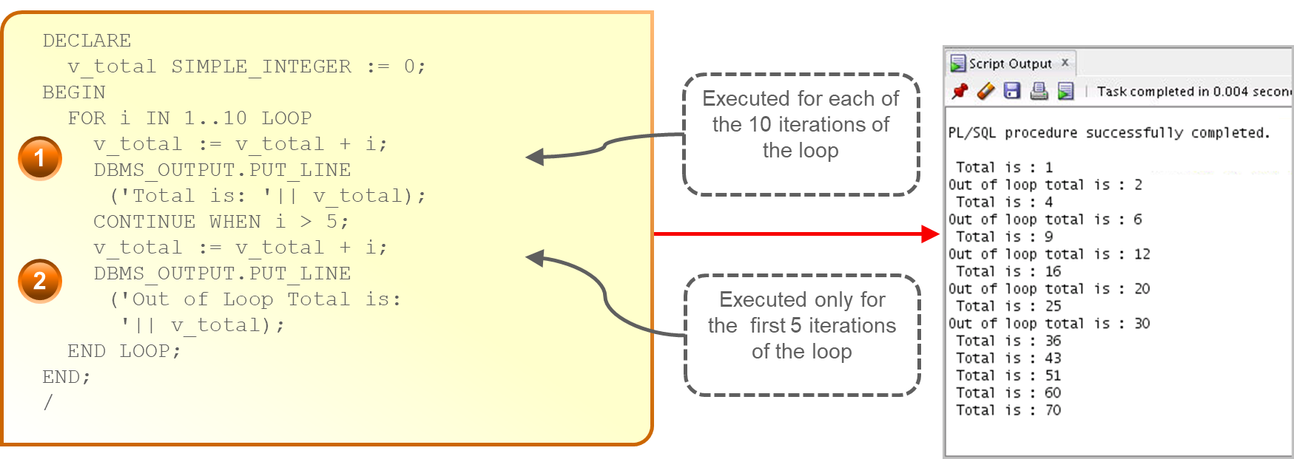
PL/SQL CONTINUE Statement: Example 1

Slide 30
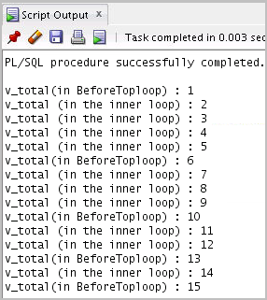
PL/SQL CONTINUE Statement: Example 2
DECLARE
v_total NUMBER := 0;
BEGIN
<<BeforeTopLoop>>
FOR i IN 1..5 LOOP
v_total := v_total + 1;
DBMS_OUTPUT.PUT_LINE
('v_total(in BeforeTopLoop): ' || v_total);
FOR j IN 1..5 LOOP
CONTINUE BeforeTopLoop WHEN i + j > 5;
v_total := v_total + 1;
DBMS_OUTPUT.PUT_LINE('v_total(in the inner loop): ' || v_total);
END LOOP;
END LOOP BeforeTopLoop;
END;

Slide 31
Quiz
There are three types of loops: basic, FOR, and WHILE.
  True
  False

Slide 32
Summary
In this lesson, you should have learned how to:
  Conditional (IF statement)
  CASE expressions and CASE statements
  Loops:
    Basic loop
    FOR loop
    WHILE loop
  EXIT statement
  CONTINUE statement

